Slide 1
Notes:
Introductory slide

Slide 2
RoadCem all over the world
Armenia
Australia
Belgium
Brazil
Bulgaria
Cameroon
Canada
China
Colombia
Congo
Croatia
Curacao
Czech Republic
Dominican Republic
Ecuador
Egypt
Germany
Greece
Guatemala
India
Iraq
Ireland
Mauritania
Mexico
Mozambique
Netherlands
New Zealand
Pakistan
Panama
Paraguay
Peru
Qatar
Russia
Saudi Arabia
Singapore
South Africa
South Sudan
Suriname
Turkey
United Kindom
USA
Vietnam
Notes:
PowerCem are now operating in the following countries with the recent additions of China and India.

Slide 3
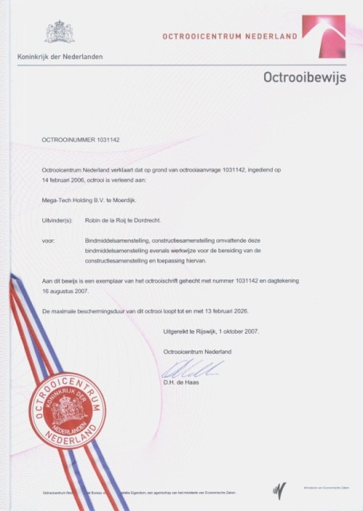
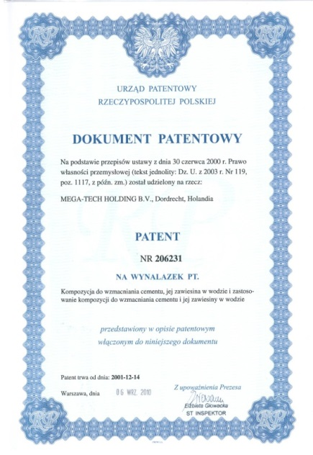
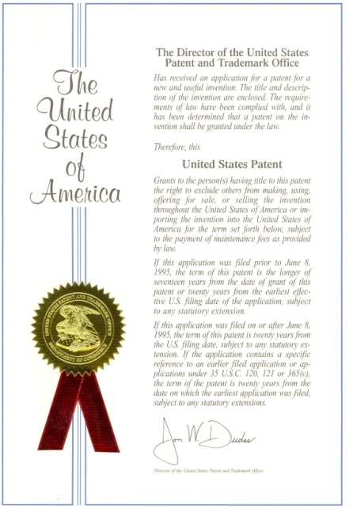
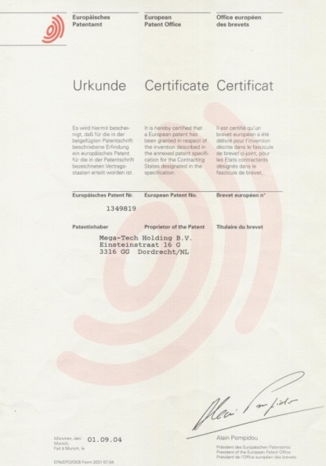
Patented Technology
Certified Production
Notes:
The Product has Worldwide Patents now in place

Slide 4
Partners in scientific research
and construction engineering
Notes:
The technology is well researched and is backed up by field application projects carried out by the large Dutch Arcadis engineering group

Slide 5
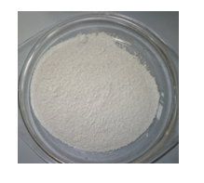
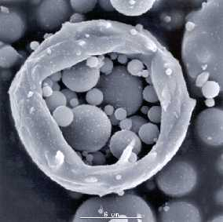
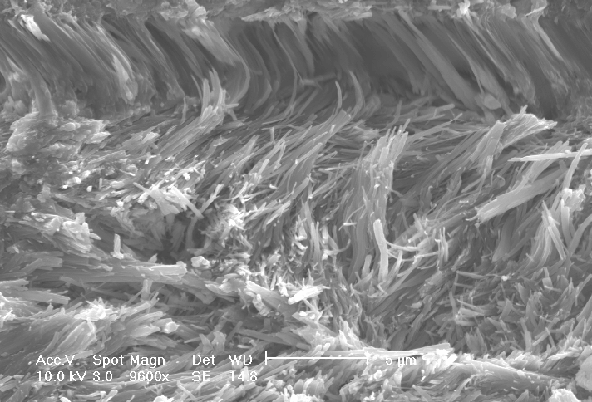
The PowerCem Technology
Special composition of synthetic zeolites and alkali earth metals
Patented
Full MSDS sheets
Produced according International ISO
Traditional Stabilisation:
With RoadCem Additive:
Cement glues the particles together
Gluing is “Brittle”!
Formation of long strings, interlocking the particles Wrapping is “Flexible”!
Notes:
Wrapping soil particles is much more effective than gluing them. The result gives greater crack free flexibility, durability and impermeability.

Slide 6
Just a little RoadCem (blue) add cement (orange) + water to meet whatever strength requirements are needed.
Notes:
Reducing materials used in construction is sustainable and smart

Slide 7
Notes:
RoadCem reduces latent bound water surface pressure surrounding the soil particles during stabilisation allowing total binding to take place

Slide 8
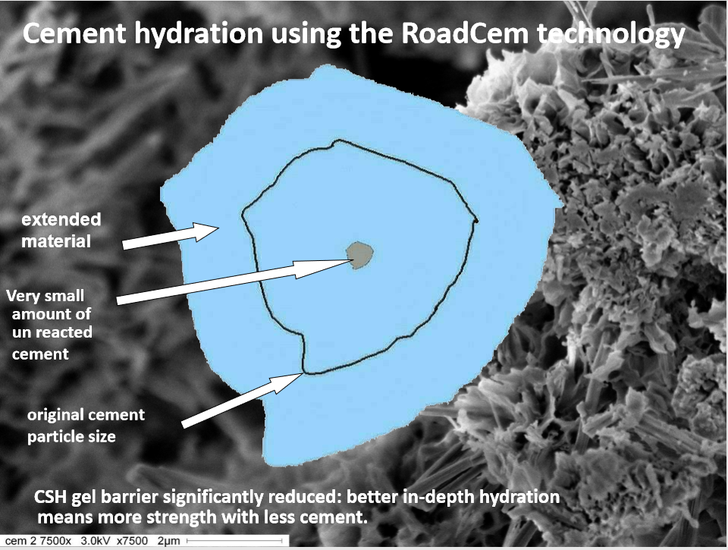
Notes:
One major flaw stabilising with cement alone is the uncontrolled paste barrier caused by the rapid formation of CSH gel which without the addition of RoadCem traps unreacted cement in the stabilisation. Potentially leaving weak voids, wasting cement and causing problems during reinstatement.

Slide 9
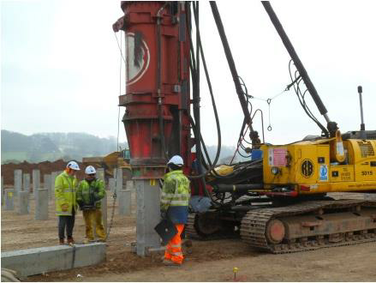
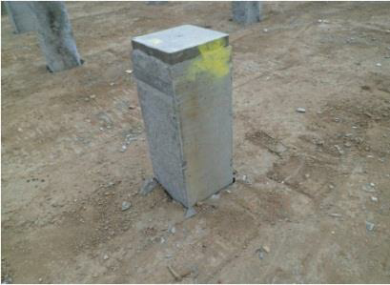
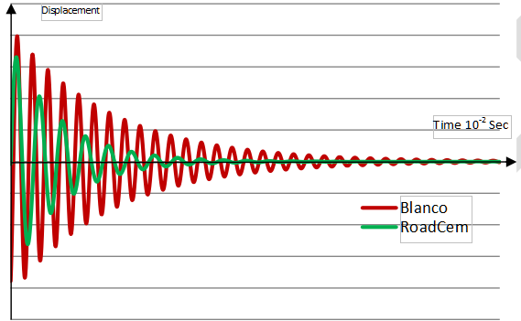
Significant Visco-Elastic Improvement by adding RoadCem
PowerCem and Delft University of Technology, simulated the properties of absorption of dynamic forces such as traffic and impacts, when using RoadCem in cement bound materials. This property is a significant added value and very important. Based on projects at Clay Mills in Derbyshire it was shown that the stabilisation could bear high intensive dynamic forces like the driving of piles through the RoadCem soil concrete. With no cracks occurring in the direct periphery of the piles nor in the completed structure on site.
By observing the longitudinal displacement mode after excitation, the dynamic modulus is obtained, proving the substantial dampening characteristics, which relate to the visco-elastic properties of the material.
It is clear that the cement only treated stabilization (Red) is showing far more vibration than the material with RoadCem added.
Notes:
Dampening and reducing vibration reduces the risk of cracking, this is important when the working platform is piled, cut or worked in any way. This Visco elastic improvement is also important for the long term integrity of road and rail base under the duress of repetitive heavy loadings.

Slide 10
RoadCem Smart technology creates stiff platforms with a greater modulus of elasticity…
Advantages of RoadCem
Notes:
Less direct impact on the subgrade, reducing the risk of subsidence, compaction and failure. Allowing the safe use of far thinner stabilised layers when RoadCem is used.

Slide 11
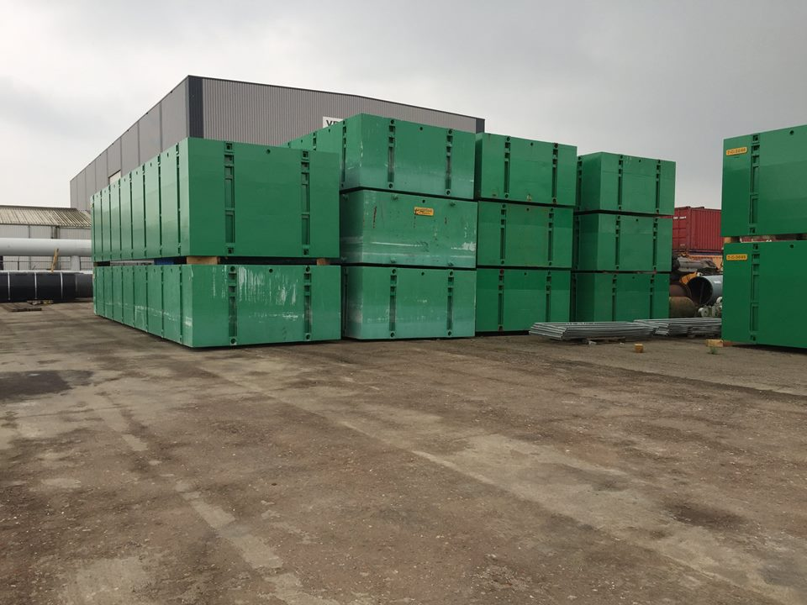
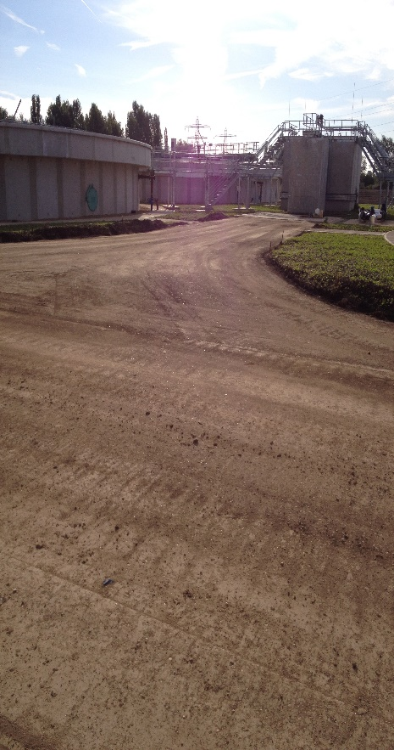
Long Term Durability
One of the earliest applications for RoadCem in Europe was at Moerdijk Harbour, The Netherlands. Where a stabilised soil hard standing for containers and plant was constructed in-situ from local soils and dredged harbour sand & silt.
Used without protective surface since 2008, the platform has proved extremely durable as this recent photo shows, as any repairs caused by accidental impact are easily dealt with, by cutting out the damage remixing and compacting back with a Wacker plate.
RoadCem durability can be seen at the Anglian Waters Flagship Cambridge STW project. The photo shows the unsurfaced soil concrete after two years construction and hundreds of trucks, plus heavy tracked plant. After cleaning; asphalt, gravel or resin and chip can be bound directly to the RoadCem.
Only the existing loamy clay soils were used in this construction. The stabilisation was used without needing any sealant or surface protection. RoadCem is a product specifically designed to engineer superior tensile strength and impermeability in to soils, providing superior long-term durability. Allowing the platform to be used unsurfaced and virtually maintenance free for the duration of the works. The high modulus of elasticity and dynamic absorption properties reduce the impact of loadings, allowing thinner stabilised layers to be used without compromise to strength or durability.
Notes:
Long term impact resistant durability and high loading strengths can be achieved with RoadCem from almost any soils.

Slide 12
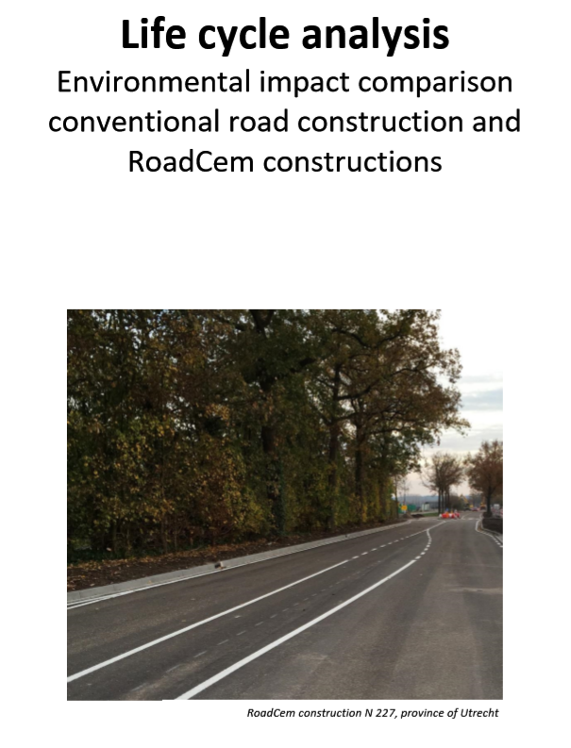
Lower Environmental Impact
We have just received a report "Environmental impact comparison conventional road construction and RoadCem Constructions" from NIBE, the Dutch Institute of Building Biology and Ecology.
In this study, a comparison was made between two equivalent structural constructions and the related environmental impacts throughout the lifetime of the constructions.
The most compelling parameters were the CO₂ emission and of increasing interest here in the UK; human toxicity.
The study shows that:
The overall environmental impact of a traditional road construction is between 172% and 240% higher than with the RoadCem constructions.
CO 2 emission of a traditional road construction is between 118% and 174% higher than with the RoadCem constructions.
Human toxicity of a traditional construction is between 277% and 361% higher than with the RoadCem constructions.
RoadCem soil concrete constructions provide a significant environmental benefit, which makes it in line with our mission and the (policy) ambitions of many of our clients.
Notes:
Copies of the full NIBE report can be downloaded online one our www.soilconcrete.co.uk web site

Slide 13
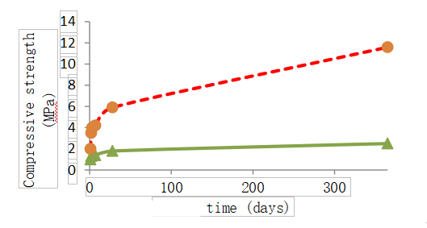
Stabilising Clay Soils
Clay is a material with fine grains. There is a large variation in the physical structure of clays. However most clay types are very plastic, due to the latent bound water on the particles. With the Nano technology of PowerCem this latent bound water is released. This latent bound water which causes the plasticity and will now join the matrix and will be part of the solid and strong crystalline structure. Clay soils treated with RoadCem will become strong, flexural bound materials.
At Delft University of Technology they compared the cement stabilisation of clays with and without RoadCem. The results were impressive.
Cement with RoadCem
Cement without RoadCem
Notes:
All the four main classes of clay soil in the UK respond well to stabilisation with RoadCem, it is important though to differentiate clay from silt when designing a suitable stabilisation mix. Silt often causes problems with its propensity to retain water, silt also binds really very well with RoadCem.

Slide 14
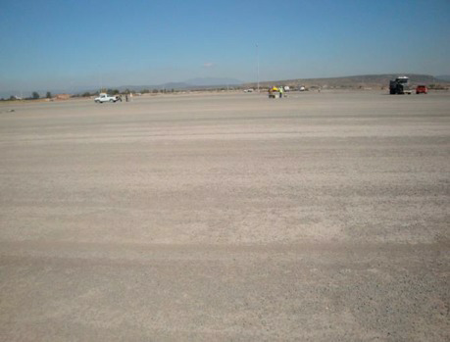
Stabilising Sandy Soils
Sandy soils are often stabilised with cement, though strong these sand-cement stabilisations are brittle and very sensitive to cracks.
Delft University of Technology have done research proving there a significant increase in flexibility achieved by adding RoadCem to a sand cement stabilized material.
The results showed clearly that RoadCem modified sand-cement is far more flexural. This scientific research confirms why no cracks will occur even on large pavement areas, such as a parking area of 600.000 m2 for GM Motors in Mexico. The sandy soil in this large car storage area was stabilised with RoadCem and cement with expansion joints placed only every 50,000 m2.
Flexural Strength | Breaking Strain | Dynamic Elastic Modulus
3.67 | 505 | 7265
3.46 | 579 | 5975
Results of both sandy soil mixes after 28 days
Notes:
Sand has been well documented to bind well with cement. The stabilisation though whilst high in compressive strength will be very brittle and prone to crack and break. Adding RoadCem will, as shown greatly increase the flexural strength achieving a high e-modulus value for long term strength.

Slide 15
Stabilising Sulphate Bearing Clays
Sulphates can have a damaging influence on the long-term durability of cement stabilised layers and pavement structures.
Cement based stabilization creates a high pH environment when mixed with water during construction. This high pH condition and the presence of lime (CaO) introduces an environment which is favourable to the formation of two expansive minerals, ettringite and possibly thaumasite.
It is the introduction and presence of available water that is the general cause of potential swelling in clay or acidic attack. Control of water both in and out and also trapped/retained in the stabilised material is critical.
This is where the active components of RoadCem become a real advantage as they break the surface bonds of any water to form a highly-reactive delivery system for the cement binder diffusing between the soil particles. These capillary forces ultimately transport the solution through the whole matrix, ensuring that the entire cement content is reactive, creating bonding forces between the soil particles and ensuring that any available water is either trapped or forced out of the stabilisation.
The absence of any mobile water in RoadCem clay stabilization’s, has been established during FireSert testing at Ulster University where extreme heat failed to create explosive spalling of available water.
RoadCem soil stabilisation technology effectively traps and encapsulates any/all water left available during stabilization. It also prevents water bourn Sulphates from entering the stabilised layers, reducing future risk of Sulphate heave by preventing any water entering the stabilisation.
Notes:
Fortunately the Dutch do not have any natural sulphate bearing soils, so research is a little light. Sherwood stated that “in all forms of sulphate attack, water is an essential part of the reaction” We know that with RoadCem no water enters the layer and no free water is available in the stabilised layer and we are confident that sulphate heave will be reduced as a result.

Slide 16
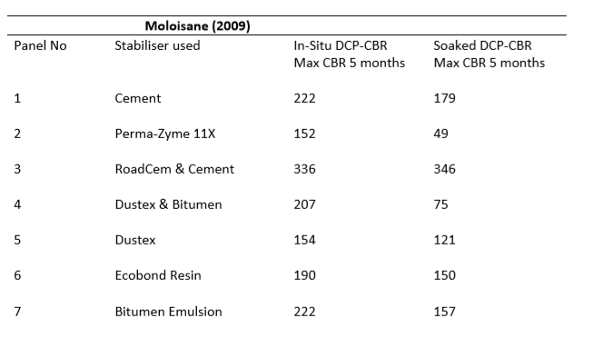
Stabilising Sulphate Bearing Clays (2)
The following published tests carried out in South Africa by Moloisane in 2009 and show that RoadCem stabilised soils when compared to other available technologies, will perform far better in soaked conditions.
Moloisane (2009) evaluated the strength behaviour of unpaved roads in areas known to have high sulphates present. Table 3.12 presents the DCP-CBR strength of the stabilised experimental panels after 5 and 8 months.
It can be seen that the soaked CBR strength decreased for every type of stabiliser, except the RoadCem and Cement treated experimental panel which showed the highest strength.
In comparison with the panel with only cement, the panel treated with cement plus RoadCem significantly outperformed all the alternatives in both in-situ and soaked conditions.
Notes:
We are very happy to be involved in any testing programme and we have are own laboratory with capability to carry out all types of testing

Slide 17
Examples world-wide implementation

Slide 18
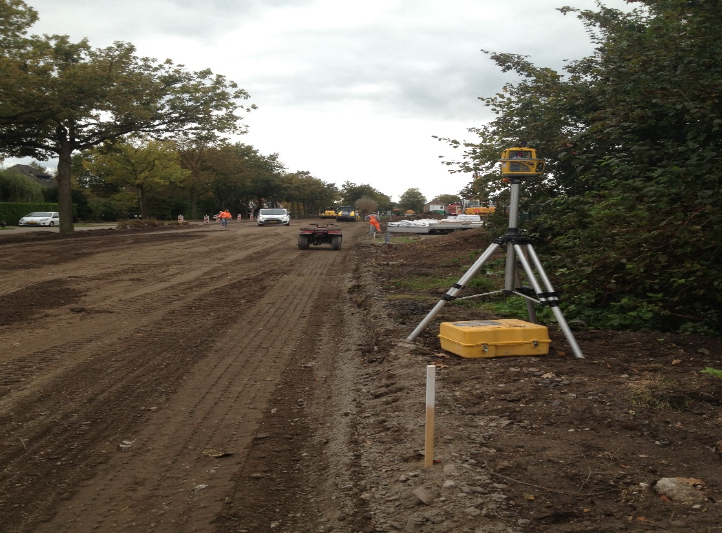
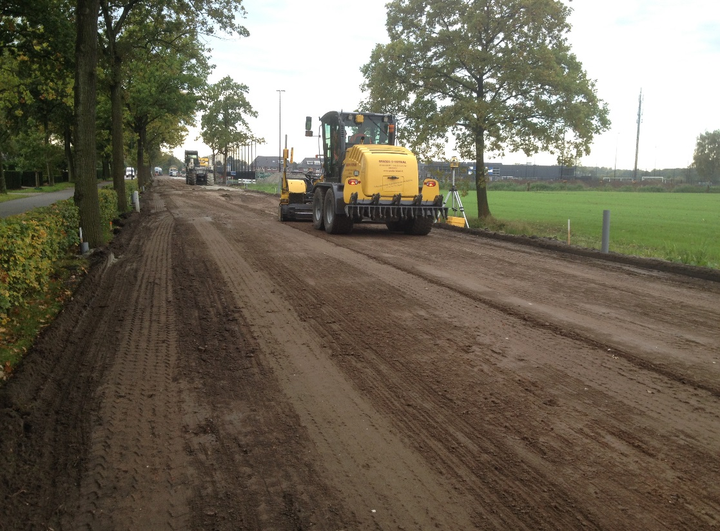
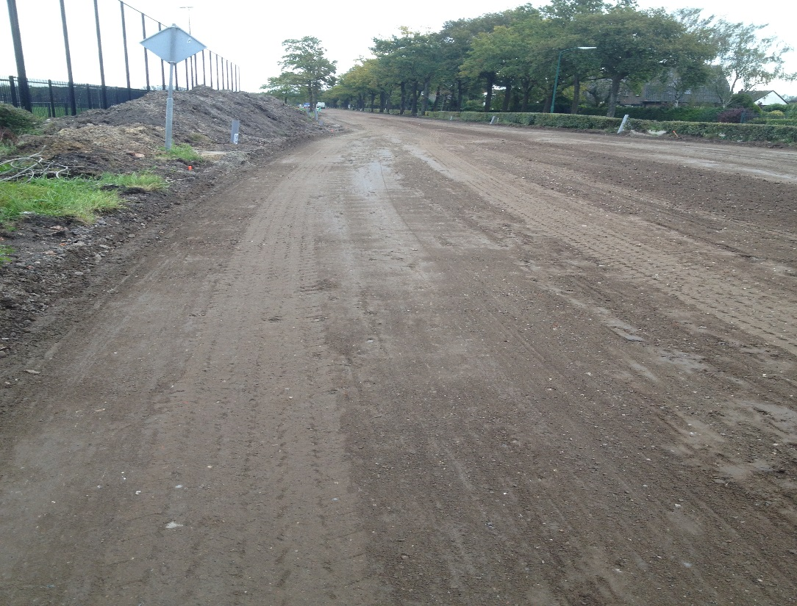
Notes:
Fast, cost effective road construction being carried out by Arcadis in Holland

Slide 19
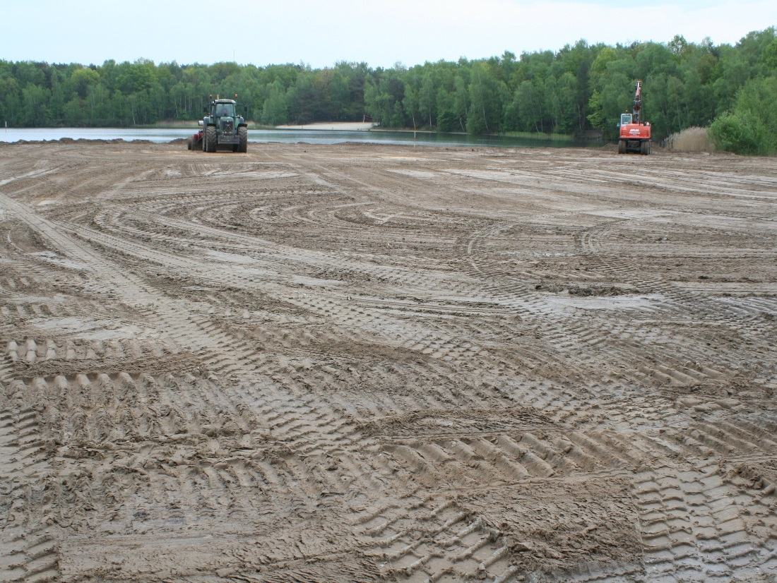
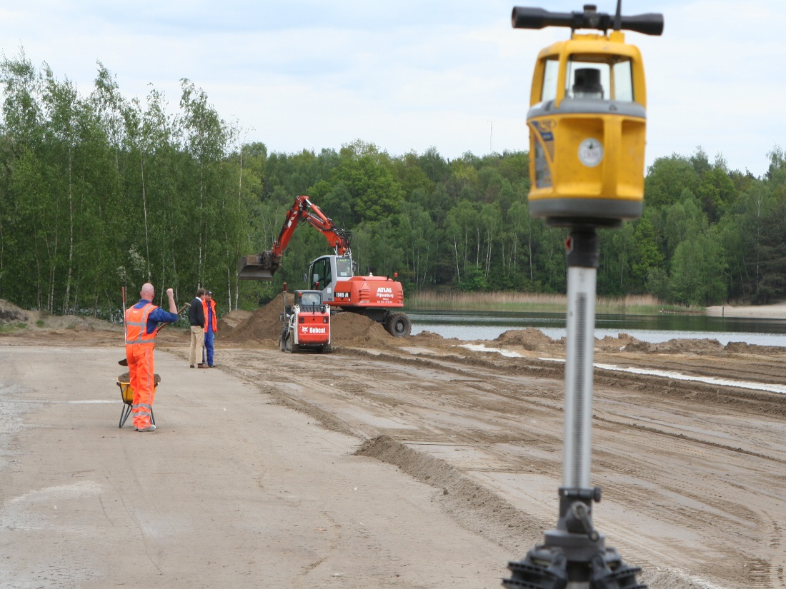
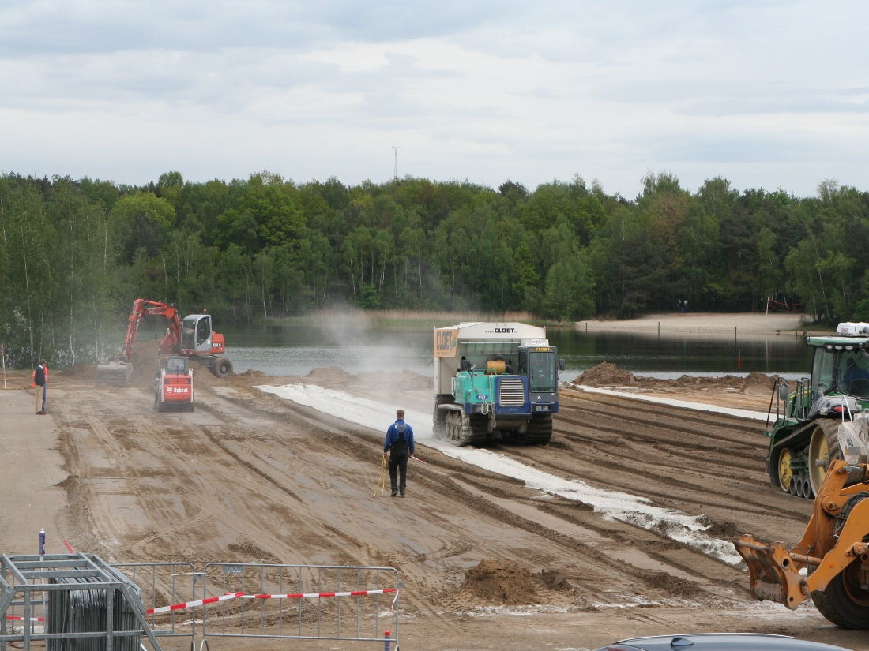
Notes:
Large RoadCem soil concrete platform built from soft organic lakeside soils, now used un-surfaced as a major concert venue in Holland

Slide 20
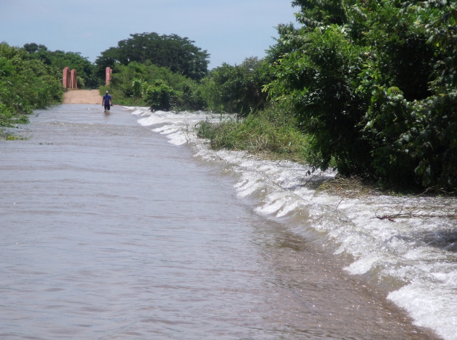
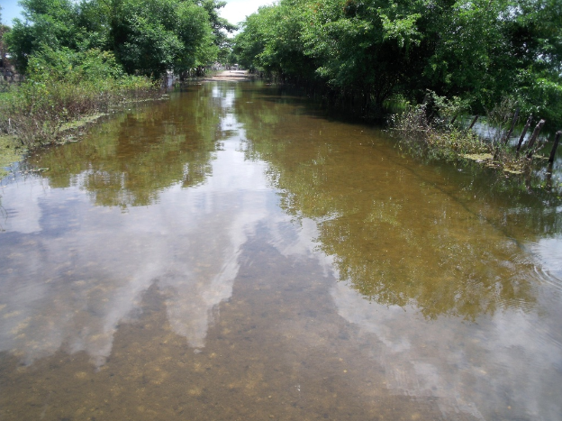
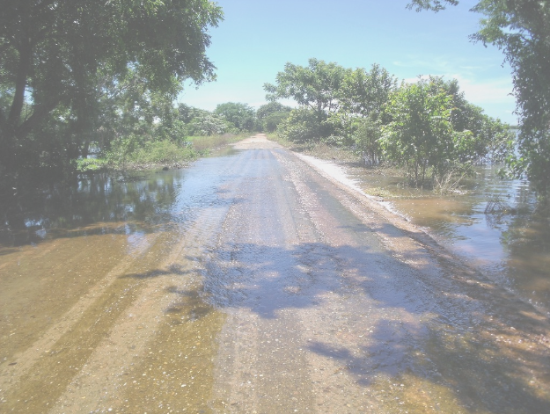
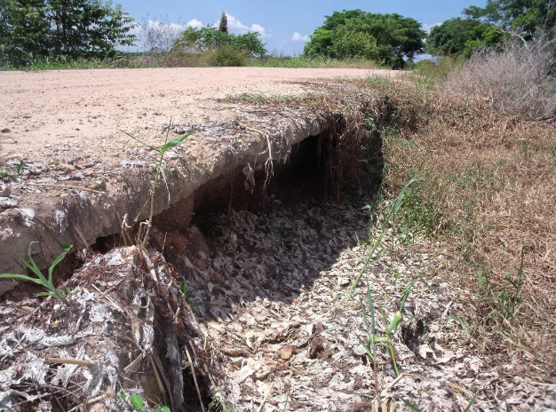
Notes:
Major annual floods in Mexico destroy conventional roads but leave the RoadCem roads intact. The UNESCO report is available as a download on web site: www.soilconcrete.co.uk

Slide 21
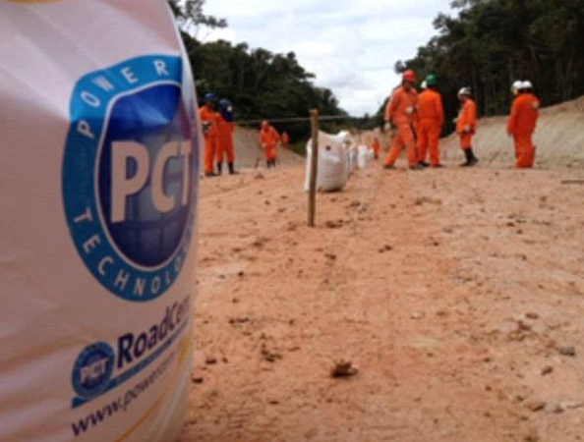
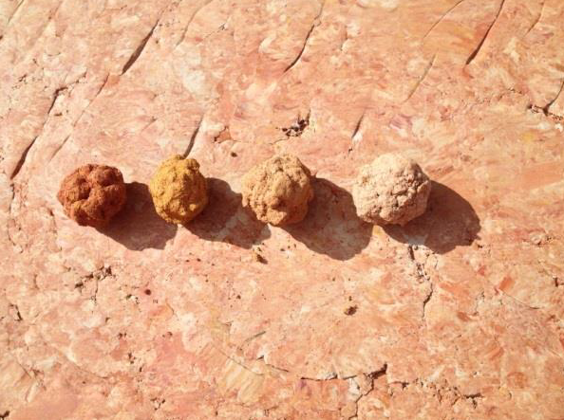
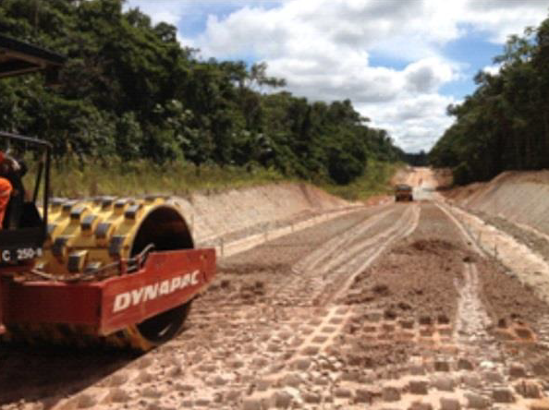
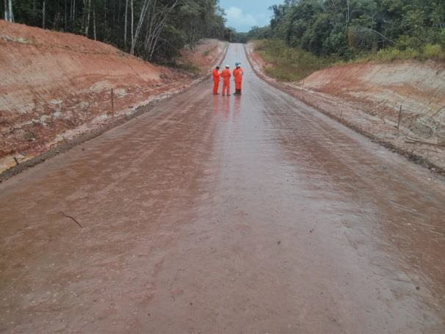
Notes:
Four different clay types, three of which were Sulphate bearing were successfully stabilised with RoadCem in the construction of this trucking road through the Amazonian rain forest. Used unsurfaced during the two year construction phase of the massive Petrobras refinery.

Slide 22
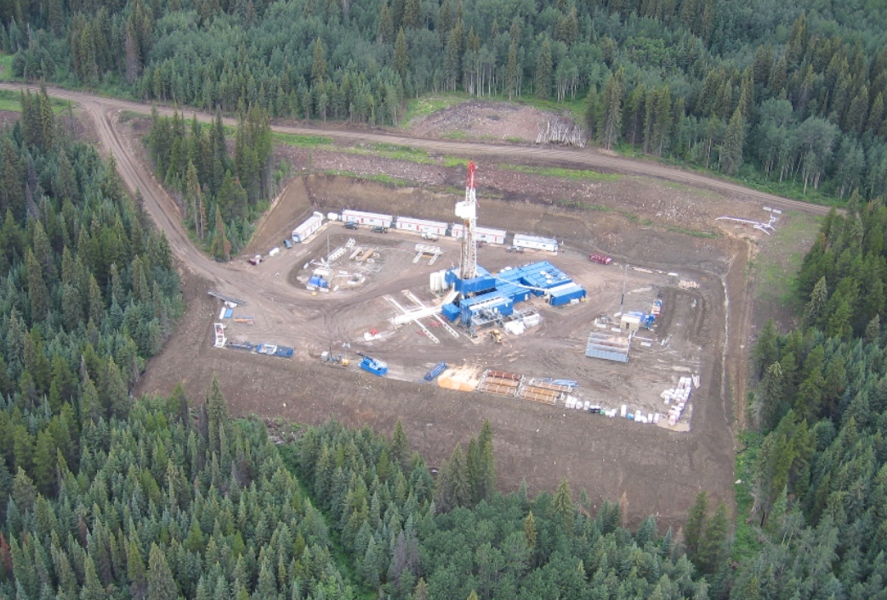
Notes:
1,200,000 lb walking drill rig, operating safely on a 350mm RoadCem soil platform. Built from the existing highly acidic Muskeg soils

Slide 23
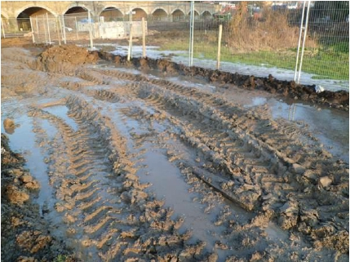
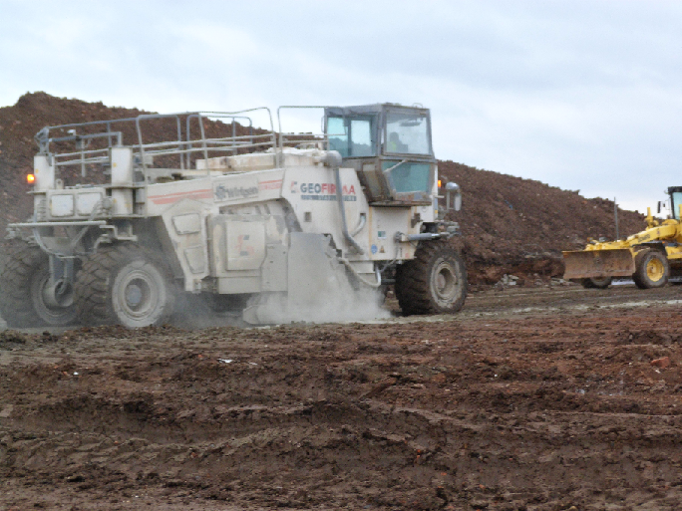
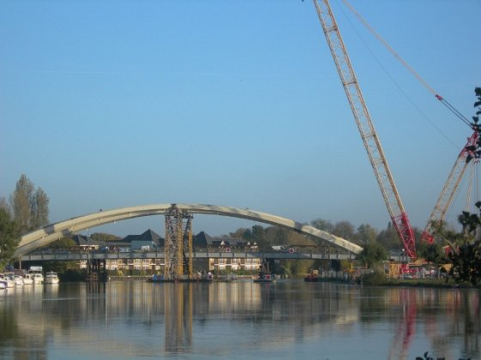
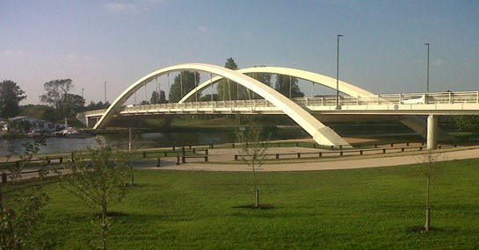
Notes:
Walton Road Bridge built by Costain using RoadCem to form the construction heavy duty soil concrete working platforms. winner of a major UK construction project award three years running

Slide 24
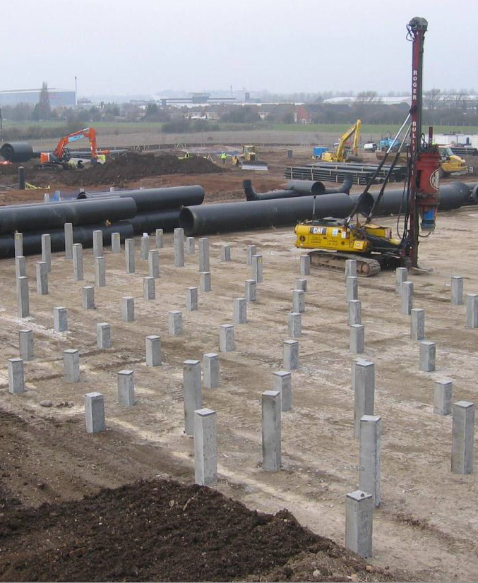
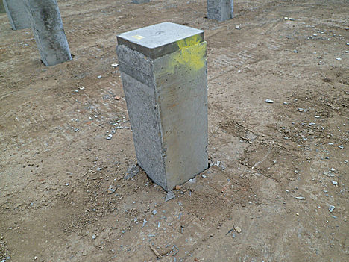
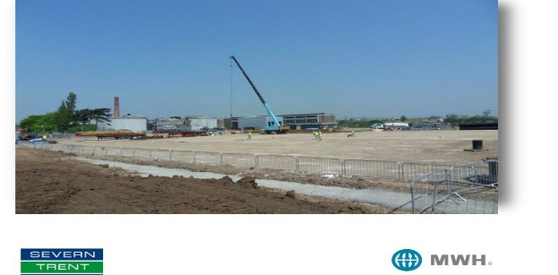
Notes:
Durable crack free piling mat built with high dynamic absorption from site won silty soils for Severn Trent.

Slide 25
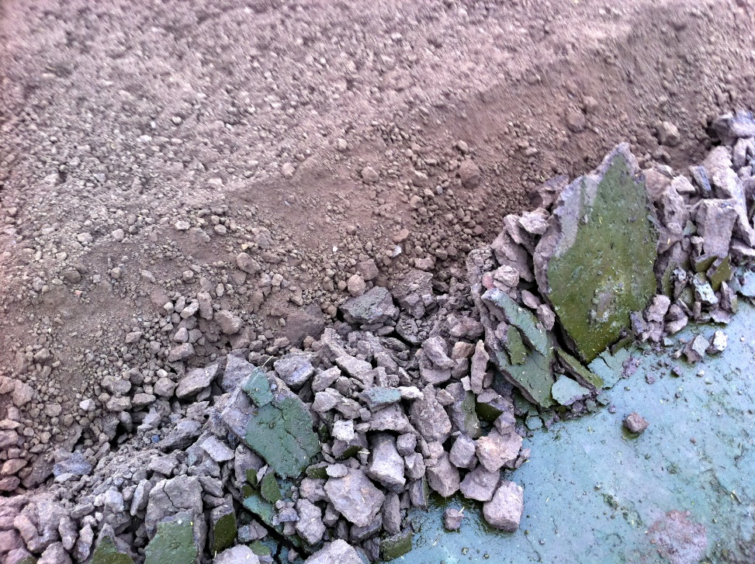
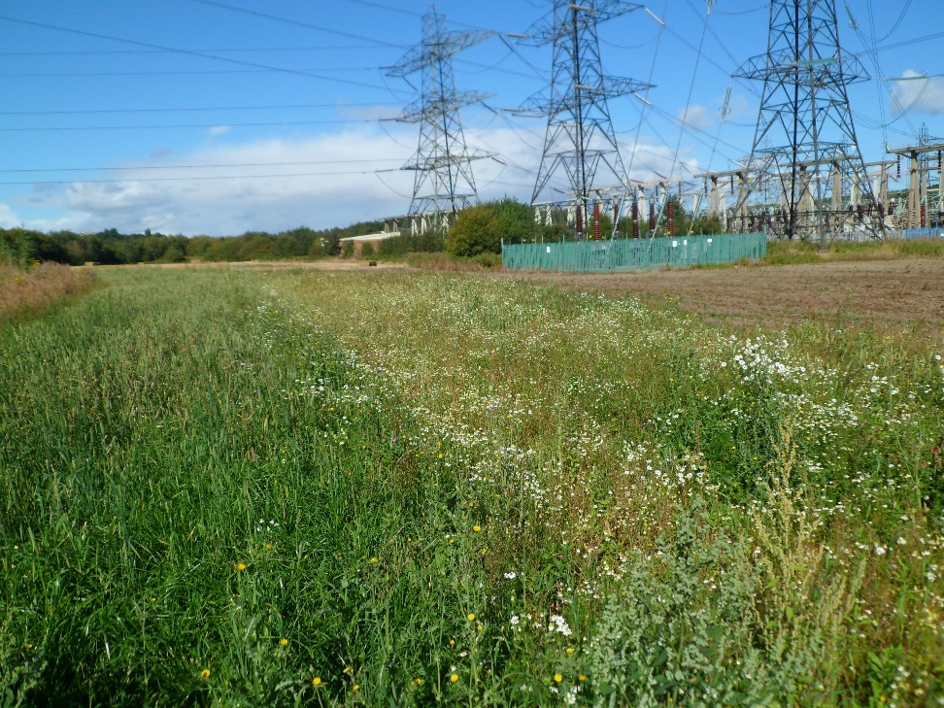
Notes:
100% recycleable haul roads built for National Grid from arable top soils at Brinsworth.

Slide 26
Example: road length 1000 m, width 7.5 m
Traditional construction RoadCem construction
113 trucks
7,5 trucks
2 560 tons of new material
168 tons of new material
1 312 tons material to dispose of
0 tons material to dispose of
7 125 liters of diesel fuel consumed
1 180 liters of diesel fuel consumed

Slide 27
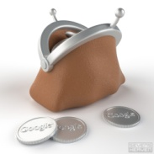
Example: road length 1000 m, width 7.5 m
Traditional construction RoadCem construction
20 days
3 days
Up to 40% cost reduction

